Slide 1
DGE.Tools OverView
John Thompson
Translational Bioinformatics
7Jan2016

Slide 2
DGE.Tools Motivation
A suite of R functions and data structures to standardize scripted DGE analysis
Standardize functions to establish common “best practice” workflows
This does NOT mean people shouldn’t experiment with variations of edgeR, DESeq2, etc.
But we should establish common, rational parameters for running each of these methods
Standardized Data Structures
Sharing a common data structure:
Improves reusability
Fosters sharing of code and data among analysts.
Facilitates use of other Bioconducter packages

Slide 3
DGE.Tools Support Areas
DGE workflow: counts to contrasts
A series of modular functions to standardize and simplify analysis while remaining flexible enough to handle many common variations
Includes support for the use of Quality Weights, Nested Designs (duplicateCorrelation), and Detrending (SVA)
Standard Data Structures
SummarizedExperiment
SubsettableListOfArray
Plotting Tools: Various QC and Data exploration tools
Dispersion plots, Pvalue Histograms, CDF Plots, Heatmaps, profile (MA) plots, volcano plots, compare plots, Gene Boxplots
Conversion: Tools for gene id mapping and datatype conversion
entrez2GeneSym, ensemblGene2Entrez, GeneSym2Entrez
countToFpkm, countToTpm, cpmToFpkm
Scalable ggplot Themes
A system of scalable-font themes and functions to facilitate reuse of graphics for both print and projections use cases.

Slide 4
DGE Tools Data Objects
Two standard data containers for expression data introduced
RangedSummarizedExperiment (RSE): for Raw processed data
The RSE object is ideal for storing the processed raw data (i.e. counts, FPKM, TPM and associated gene and sample annotation.
The RSE has a single slot each for row (gene) and column (sample) annotation and can hold as many “assays” (Counts, etc) as you like.
There is also a slot for metadata that has neither a row or column association
Advantage: The rowData slot is a GRanges object that contains chromosome coords useful for downstream displays in genome context
Disadvantage: The RSE cannot hold a limma Fit object.
SubsettableListOfArrays (SLOA): For capturing limma analyses
The SLOA is similar to the RSE except:
It accommodates multiple sets of row or column data
It accommodates limma Fit objects as a row element (gene oriented)
Thus the SLOA is better suited to holding downstream results (e.g. Fit objects)
Subsetting: Both of these objects can be subsetted with square brackets like a matrix and all embedded objects are appropriately subsetted.

Slide 5
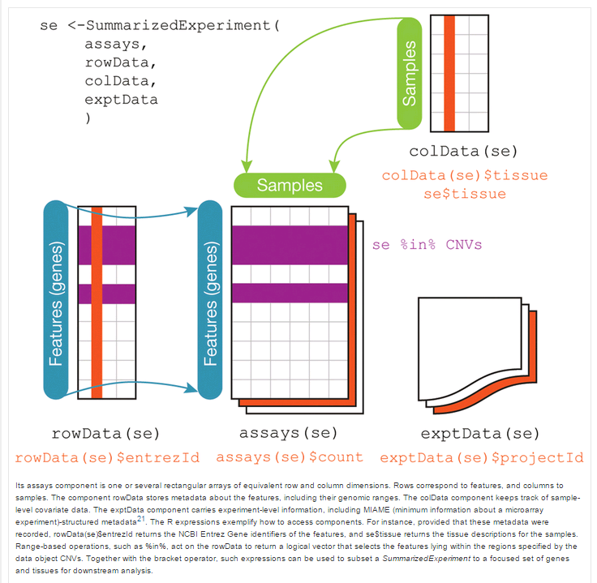
Summarized Experiment structure
Notes:
rowData was changed to rowRanges
exptData was changed to metadata

Slide 6
DGE.Tools: DGE Pipeline Functions
Main Functions: listed in typical order of use
Build_RSE: Convert Text Files to RSE data structure
Minimally requires Counts, Gene Annotation and Sample Annotation
Produces a RangedSummarizedExperiment (RSE) object
runEdgeRNorm: Perform edgeR TMM normalization
Requires an RSE, Model Formula and Design Table
Produces a SummarizedListOfArrays (SLOA) containing data and DesignMatrix
runSVA: Surrogate Variable analysis for detrending unknown factors
Requires an SLOA; Adds surrogate factors to DesignMatrix and Design Table
Captures the svobj for further inspection
runVoom: run limma voom and lmFit
Require an SLOA; Fits the model and adds the Fit object to the SLOA
Optionally supports QualityWeights and DuplicateCorrelation analyses
runContrasts: run multiple contrasts against the lmFit Fit object
Requires an SLOA with Fit; Produces a List object with topTable and topTreat contrast tables
Includes alternative FDR measures: Qvalues, LFDR, Independent Hypothesis Weighting (IHW)

Slide 7
DGE.Tools: DGE Plotting Functions
QC Plots:
plotDispersion: EdgeR dispersion plot
Mean-variance: voom mean variance plots
Quality Weights: voom barplot of quality weights
plotPvalHist: evaluate distribution of pvalues
plotCDF: alternative way to evaluate pvalue distributions
Data Exploration Plots
profilePlot: LogIntensity vs LogRatio
volcanoPlot: LogRatio vs NegLogPval
comparePlot: LogRatio of 2 treatment groups
JRT_heatmap: Convenience wrapper for pheatmap function

Slide 8
Basic DGE Analysis in a dozen lines or less
Tabbed Txt
MyRSE = Build_RSE(GeneData, Species=Human,
OutputPath = "./Rdata", PlotFile = "zFPKM.png")
F. Build_RSE
RSE
present = assay(MyRSE, "Gene.zFPKM") > -3
present.all = apply(present, 1, sum) == ncol(present)
present.any = apply(present, 1, sum) > 0
pRSE = MyRSE[present.any, ]
zFPKM >-3:
pRSE
F. runEdgeRNorm
MySLOA = runEdgeRNorm(pRSE, MyFormula, MyDesign)
SLOA
F. runVoom
MySLOA = runVoom (MySLOA, PlotFile="MVplot.png")
SLOA
MyContrasts = list(T1sig = "Treament1 - Veh",
T2sig = "Treatment2 - Veh")
Contrasts = runContrasts(MySLOA, MyContrasts)
F. runContrasts
Contrast List

Slide 9
DGE Workflows : Illustrated Overview
Build_RSE
RSE
zFPKM
RSE
runEdgeRNorm
SLOA
SLOA
runVoom
qualityWeights=FALSE
runVoom
runVoom
dupCor=TRUE
runSVA
SLOA
SLOA
runContrasts
Contrast List
Plot Tools

Slide 10
Build_RSE Function
Input = Tabbed Text for:
Row (gene) and Column (sample) annotation
Row annotation should have chr, start, end, strand info
“assay” data: Counts (required)
Optionally: FPKM, CPM, TPM, zFPKM
Metadata: any dataframe not row or col oriented
Preconfigured for Omicsoft Pipeline output
Easily reconfigured for files from other pipelines
Output = RSE object
Example:
MyRSE = Build_RSE(GeneData, OutputPath=“./Rdata”)
saveRDS (MyRSE, file=“./Rdata/MyRSE.RDS”)

Slide 11
Genedata and Transcriptdata
List of lists defining input files
GeneData = list(
Annotation = list(name = "Gene.Annotation", file = "RNA-Seq.Count.Annotation.txt", type = "rowRanges"),
Design = list(name = "Design", file = "RNA-Seq.Design.txt", type = "colData"),
Counts = list(name = "Gene.Counts", file = "RNA-Seq.Count.Table.txt", type = "Assay"),
Level = list(name = "Level", level = "Gene", type = "metadata"
)
These 4 items required; can add other items
Customize filenames for data from other pipelines
Only one slot each for row and column data; multiple slots for metadata
Row data requires chr, start, end, strand info and any other columns

Slide 12
Accessor methods for RSE objects
Accessor Functions used to extract parts of the RSE objects
• print(RSE) #prints a summary of the contents
• MyCounts = assay(RSE, “Gene.Counts”) #returns a matrix
• MyTPM = assay(RSE, “Gene.TPM”) #returns a matrix
• MyzFPKM = assay(RSE, “Gene.zFPKM”) #returns a matrix
• MySampleAnnotation = colData(RSE) #Returns a DataFrame (behaves similar to data.frame)
• MySampleAnnotation = colData(RSE) %>% as.data.frame #Returns a base data.frame
• MyGeneAnnotation = mcols(RSE) %>% as.data.frame
• QC.Metrics.Summary = metadata(RSE)[[“QC.Metrics.Summary”]] #Returns a DF of alignment stats
• Created = metadata(RSE)[[“Created”]] #Returns a list of object documentation

Slide 13
Use zFPKM to select expressed genes
Validated with encode open/closed promoter chromatin structure epigenetic data on six of the ENCODE cell lines.
Works well for gene level data using FPKM or TPM
Does not appear to calibrate well for transcript level data.
Reference recommends using zFPKM >-3 to select expressed genes.
Reference: Hart et al., 2013 (Pubmed ID 24215113)
R Implementation: Ron Ammar
Packaged by: JRT
Note: you should use zFPKM or some other method to remove undetected genes or your model fit will be compromised.

Slide 14
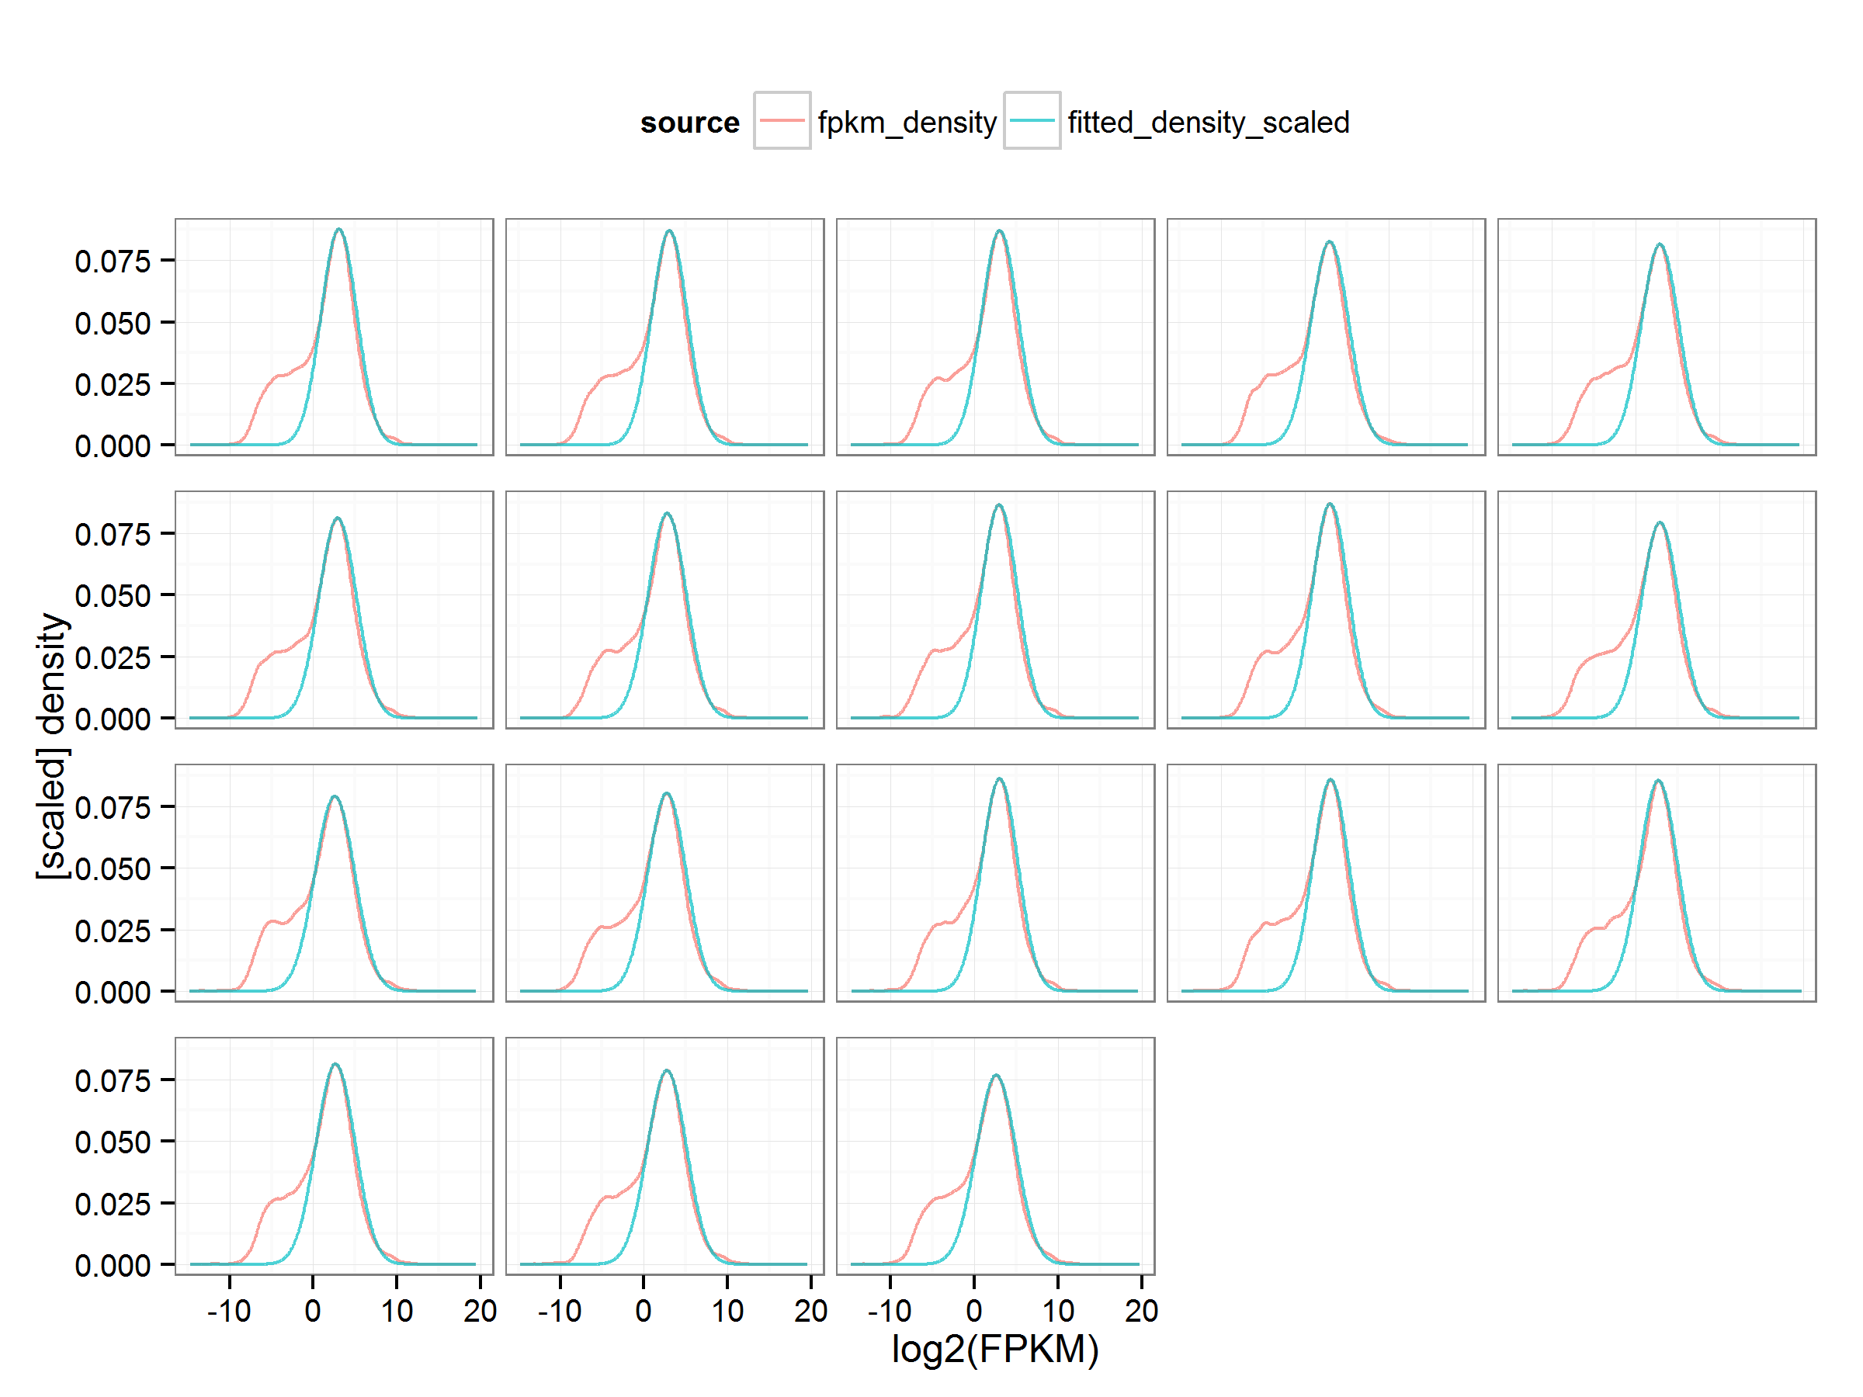
zFKPM Procedure and Plot
FPKM, TPM plots shows bimodal distribution (red)
Larger, right peak corresponds to genes with open promoters
Fit right half of right peak, then mirror to fit the expressed gene distribution
Calculate Zscores from the fit curve (blue)
Use only with Gene Level (not transcript level)

Slide 15
Using zFPKM to filter for expressed genes
zFPKM = assay(RSE, "Gene.zFPKM") #extract zFPKM from RSE object
present = zFPKM > -3 #boolean matrix true for each gene above threshold
#count genes present for each sample
samplePresent = apply (present, 2, sum)
#Define three different stringency filters
present.all = apply(present, 1, sum) == ncol(present)
present.50 = apply(present, 1, sum) >= (ncol(present)/2)
present.any = apply(present, 1, sum) >= 1
#use present.any to filter the RSE object
pRSE = RSE[present.any,]
#extract the counts for present genes
MyCounts = assay(pRSE, “Gene.Counts”)

Slide 16
Normalization: F. runEdgeRNorm
Input:
RSE object
Formula
Design table (data.frame)
Runs edgeR TMM normalization by default
Use NormMethod argument to specify other normalizations
Returns: SLOA object containing
DGElist: containing TMM normalized Log2CPM
Row and col annotation and counts
DesignMatrix and Design table
Example:
MySLOA = runEdgeRNorm(pRSE, MyFormula, MyDesign)

Slide 17
Fit Model: F. runVoom
Input:
SLOA object with DGElist (containing normalized log2counts)
Runs limma voom followed by lmFit
runs voomWithQualityWeights by default
Duplicate correlation requires SLOA$colData$block data column
Returns: SLOA object
Now containing Fit object and other model-associated data
Examples:
MySLOA <- runVoom (MySLOA, PlotFile = "MVplot.png")
#with duplicateCorrelation
MySLOA <- runVoom (MySLOA, dupCor = TRUE)
#turn off QualityWeights
MySLOA <- runVoom(MySLOA, qualityWeights = FALSE)
#Save the results
saveRDS (MySLOA, file = "MySLOA.RDS")

Slide 18
Surrogate Variable Analysis: F. runSVA
Input:
SLOA object from runVoom
Runs SVA analysis
Determine number of unobserved surrogate variables
Add surrogate variable data to Design table and DesignMatrix
Returns: Updated SLOA Object
Design table and DesignMatrix updated with surrogate variable data
Repeat runVoom after running SVA, now including the surrogate variables in the analysis
Example:
MySLOA = runSVA(MySLOA)

Slide 19
SLOA structure
SLOA Definition Code: (Informational; you don’t need to include this)
SLOA <- defineSLOASubclass("SLOA",
I="RowRanges",
IX=c("rowData", "Fit"), #objects indexed as rowdata
JX=c("colData", "DesignMatrix ", " var.design "), #objects indexed as col data
IJ=c("RSE", "DGElist", "Elist", "Counts", "FPKM",
"Log2CPM", "TPM", "Residuals"), #data matrices
required=c("rowData", "colData", "Counts"))
SLOA Construction:
#note the RSE should first be filtered to remove non-expressed genes
source ("~/R/lib/SubsettableListOfArrays.R")
MySLOA = runEdgeRNorm(RSE, MyFormula, MyDesign)
MySLOA = runVoom (MySLOA, PlotFile="MVplot.png")

Slide 20
Contrasts: F. runContrasts
Input: SLOA object with Fit and DesignMatrix
Supports: topTable and/or topTreat analysis
Output: a List of result objects
#build a list of lists naming and describing contrasts
MyContrasts <- list(
T1sig = "Treament1 - Veh",
T2sig = "Treatment2 - Veh"
)
DTcontrasts <- runContrasts(MySLOA, MyContrasts)
> names(DTcontrasts)
"ContrastMatrix"
"Fit.Contrasts"
"TopTableList"
"TopTreatList"
"SigCountsSummary"
"Created"
From makeContrasts and contrasts.fit
List of topTable/topTreat dataframes
Significant Gene counts for all contrasts
SessionInfo and other documentation

Slide 21
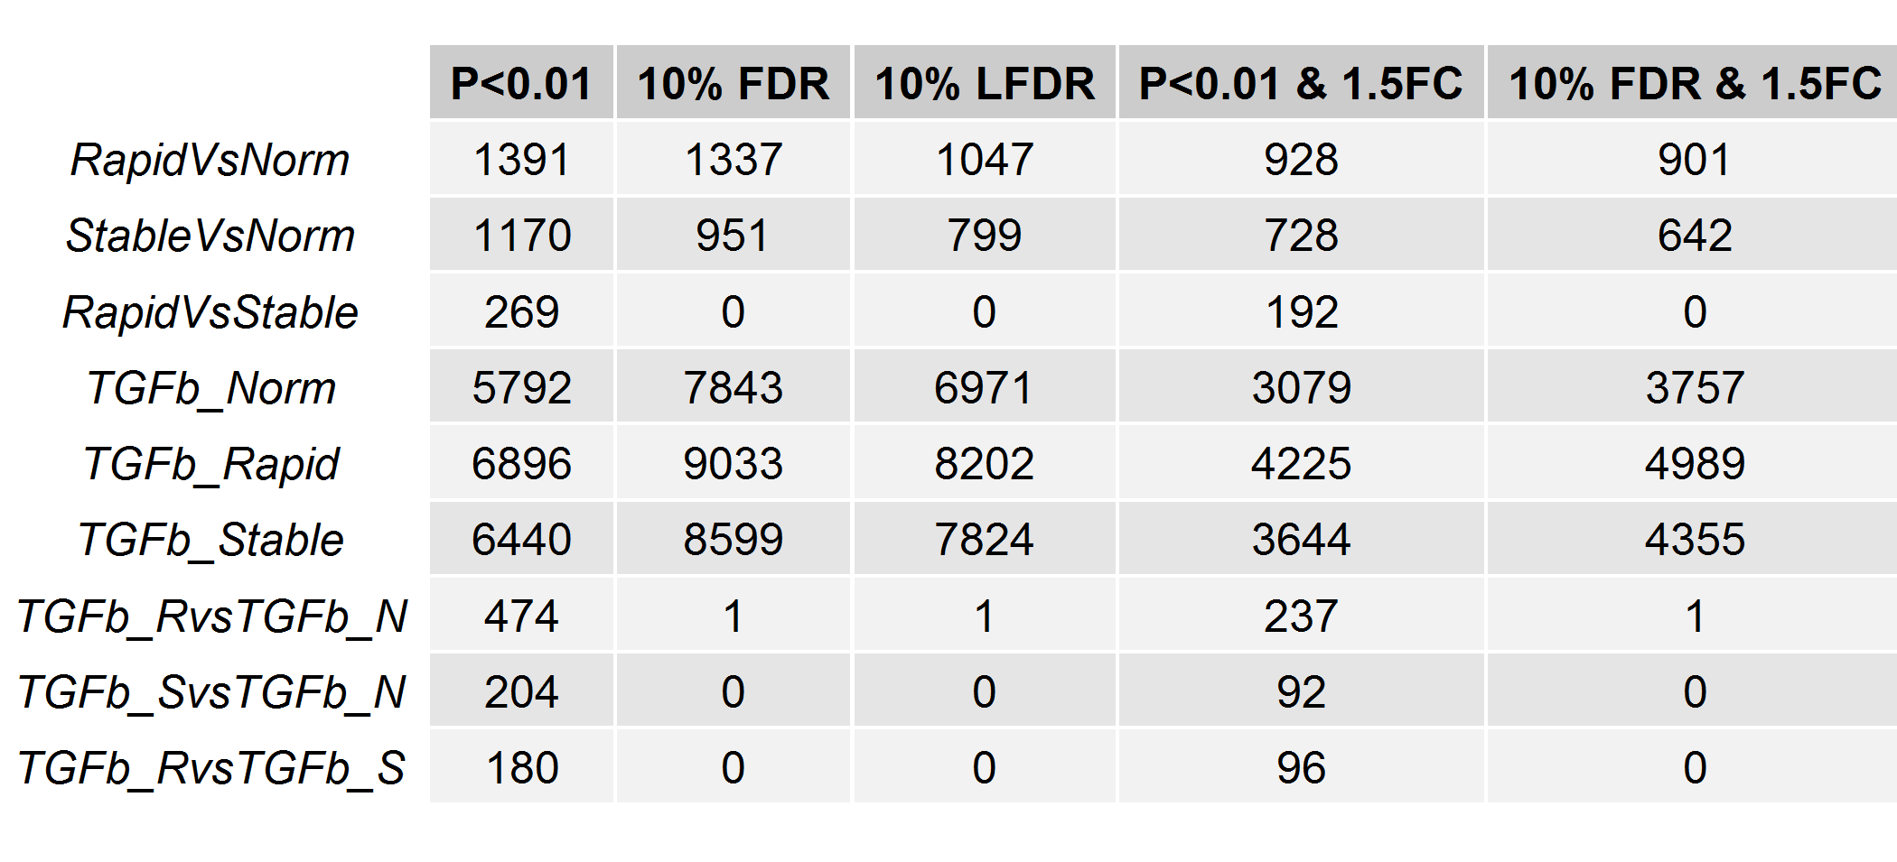
Contrast Summary Table:
MyContrasts$SigCountSummary
topTable
qvalue
topTreat
FDR = BH FDR from topTable/topTreat
LFDR = local FDR from qvalue package

Slide 22
DGE Workflows : Illustrated Overview
Build_RSE
RSE
zFPKM
RSE
runEdgeRNorm
SLOA
SLOA
runVoom
qualityWeights=FALSE
runVoom
runVoom
dupCor=TRUE
runSVA
SLOA
SLOA
runContrasts
Contrast List
Plot Tools

Slide 23
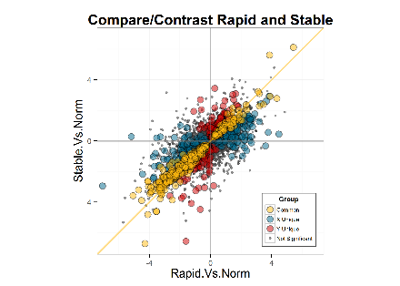
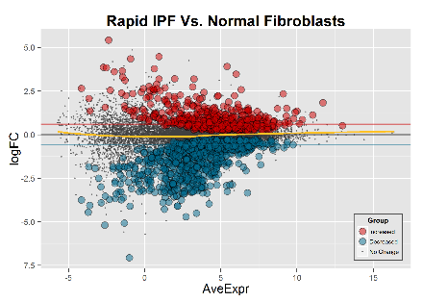
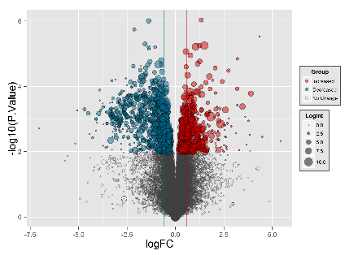
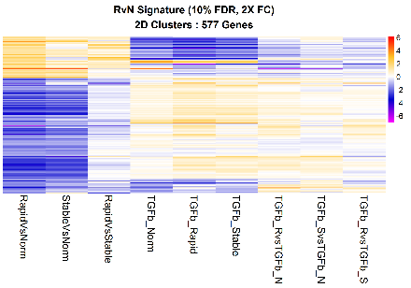
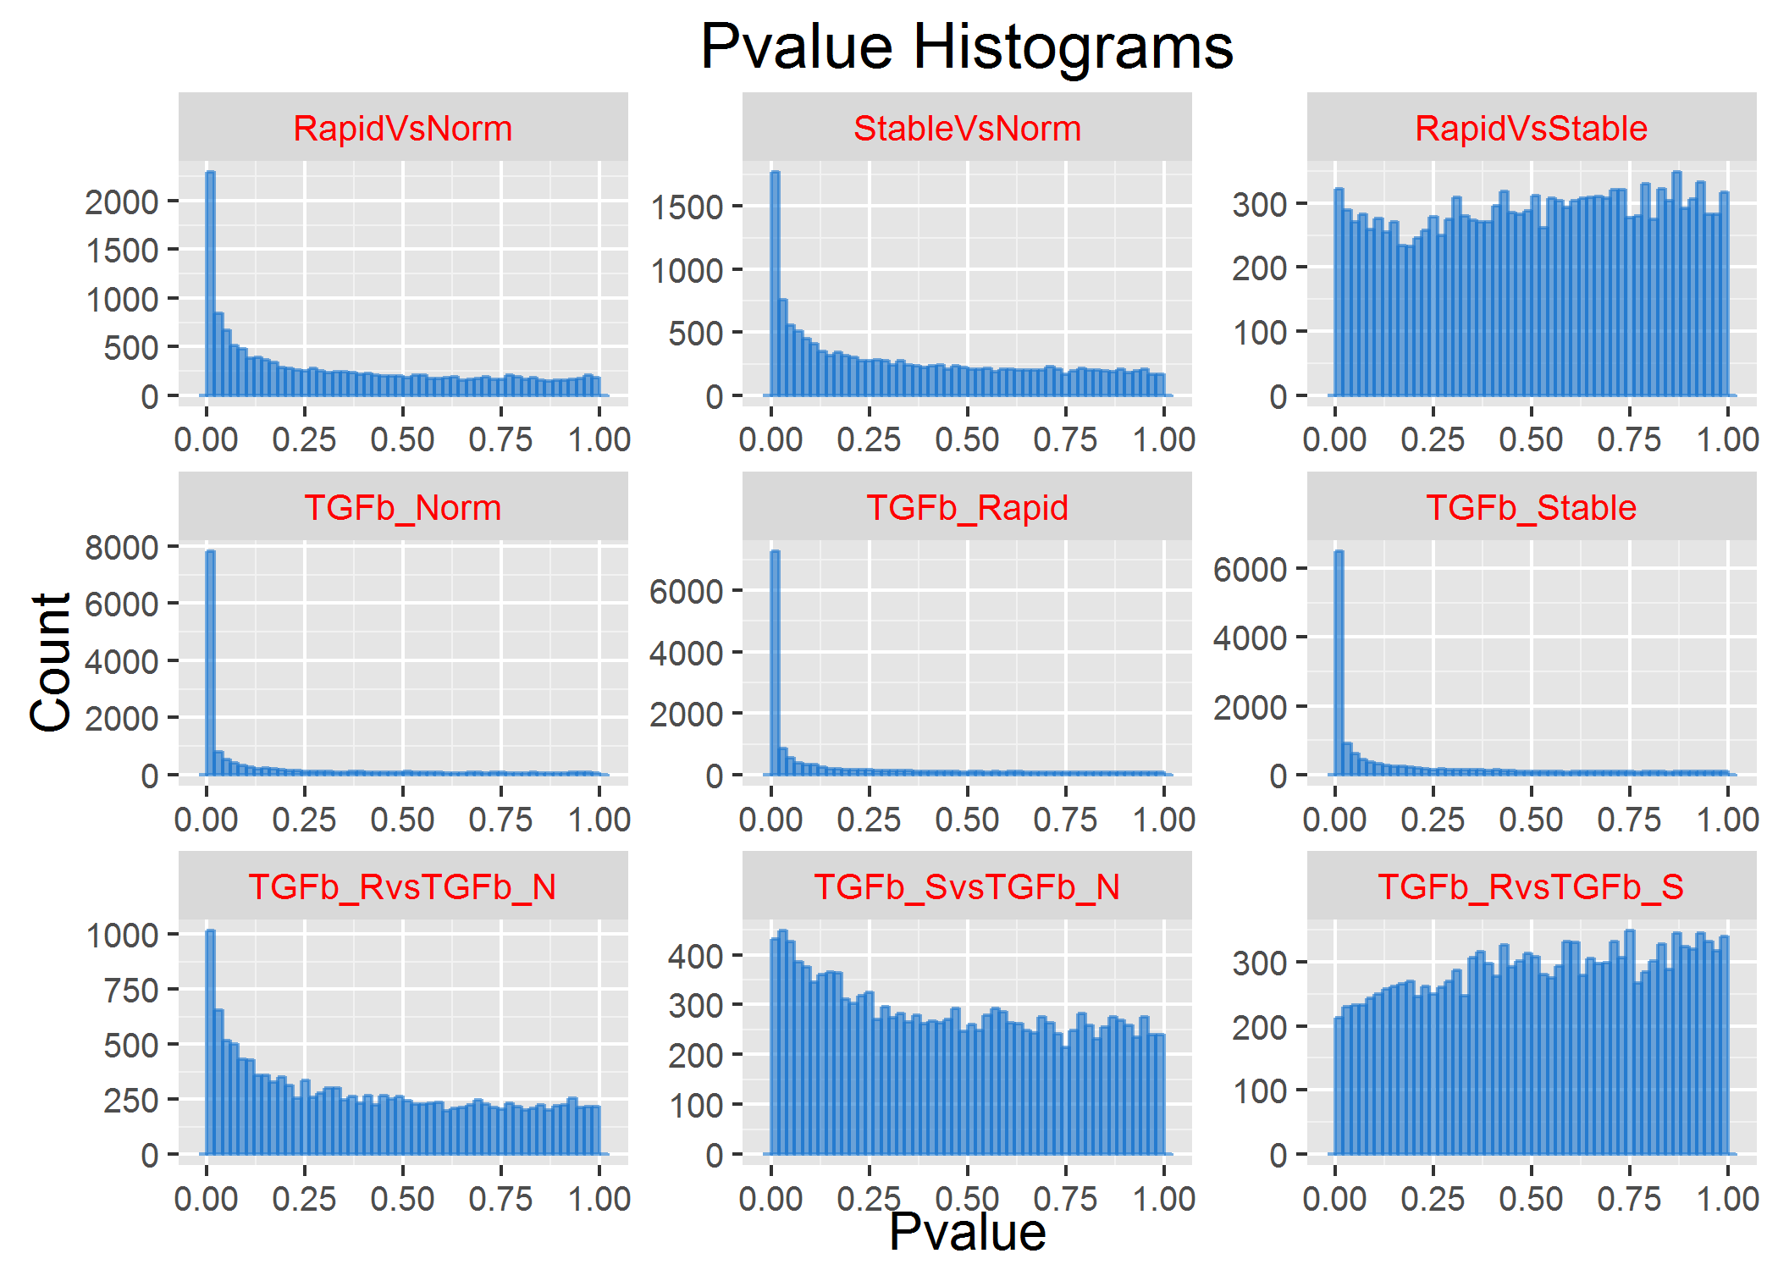
Exploratory Data Analysis
runQvalue
Alt FDR
Methods
runContrasts
Contrast List
runIHW
Contrast List
plotDispersion
comparePlot(df)
Plot Tools
ggplotMDS
RSE
SLOA
Contrast List
plotPvalHist
profilePlot
profilePlot(RvN)
volcanoPlot
profilePlot(RvN)
cdfPlot
obsPlot
comparePlot
JRT_heatmap
JRT_heatmap(LogRatios)
profilePlot(RvN)

Slide 24
Installing DGE.Tools
The DGE.Tools and zFPKM packages have been deposited in the BMS Github and can be installed with the following commands:
Library(devtools)
install_git("http://biogit.pri.bms.com/thompj27/zFPKM")
install_git("http://biogit.pri.bms.com/thompj27/DGE.Tools", repos=BiocInstaller::biocinstallRepos())
library(DGE.Tools)
There is still one critical piece of R source that breaks when encapsulated in a package. The SubsettableListOfArrays.R file still needs to be manually copied to your drive and sourced whenever you are manipulating SubsettableListOfArray objects (i.e. the output of runEdgeRNorm and runVoom functions).
Download SubsettableListOfArrays.R from: http://bioinformatics.bms.com/active/biohtml/thompj27/DGE.Tools/SubsettableListOfArrays.R
Place it somewhere on your computer. (Suggestion "~/R/lib/")
In R, source the file with:
source("~/R/lib/SubsettableListOfArrays.R")
(Updated 11Dec2015)

Slide 25
Sample Data and Markdown
Sample Data
IPF Fibroblasts from normal, rapid and slow progressors
3 donors each; 9 cell lines total, treated and untreated.
Challenged in vitro with Veh or TGFB
Data Folder : /home/thompj27/CedarSinai_IPF
setwd(“<yourpath>/CedarSinai_IPF”)
Then load and knit Build_RSE_Object.rmd
Creates ./Rdata/MyGene_RSE.RDS
The knit PDF (Build_RSE_Object.pdf) is a tutorial on how to access data contained in a RSE object
Analysis Folder : /home/thompj27/CedarSinai_IPF/Rdata
setwd (“<yourpath>/CeaderSinai_IPF/RData”)
Then load and knit FitAndRunContrasts.Rmd
Loads MyGene_RSE.RDS and creates DT_Model_SLOA.RDS and DT_Model_Contrasts.RDS

Slide 26
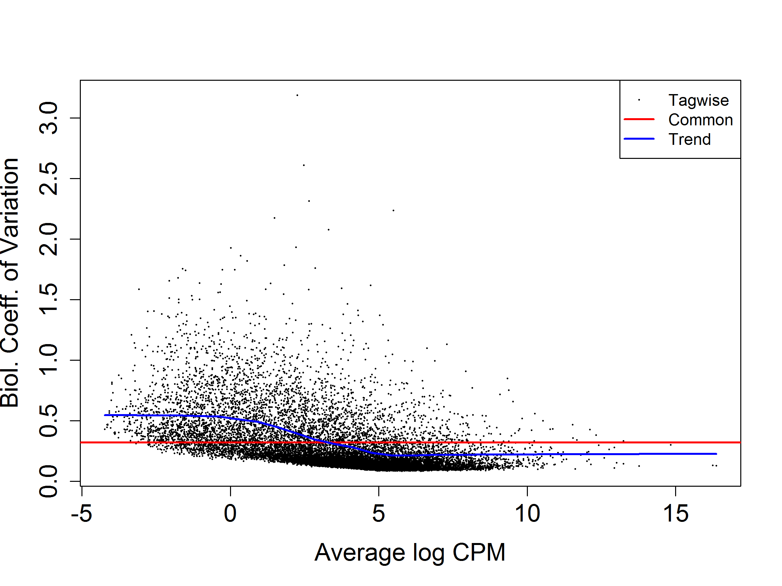
Example plotDispersion QC plot {edgeR}
Red line is for Reference. Blue line is a loess fit and should be mostly at or below the redline. Dots represent genes with high points either the regulated genes or (mostly low intensity) noise.

Slide 27
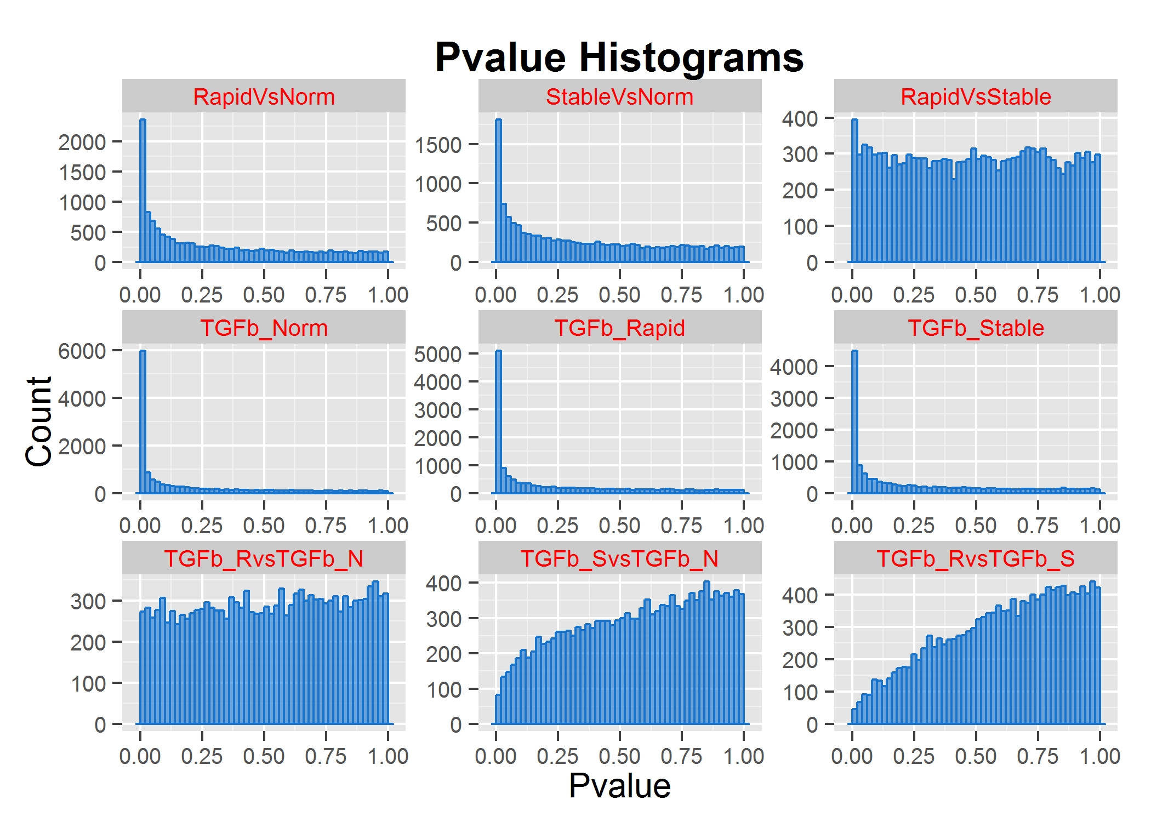
F. plotPvalHist Example
Weaker sig
No sig
Stronger sig
Weird
(see Scott)
Should be flat with a peak near zero if there are bona-fide regulated genes.

Slide 28
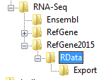
Suggested File/Folder Organization
Top level
Copy contents of ExportedFilesAndFolder (Omicsoft Output)
Run Build_EO_Object.rmd in this folder.
Create a subfolder for R analysis files
Omicsoft Data
R Scripts and output (RDS files)
Exported GeneLists from R

Slide 29
Current and Future RNA-Seq Pipeline
current
FastQ on
Linux or Cloud
Omicsoft
Pipeline
Omicsoft
DB
Omicsoft
Output
CG Pipeline
Xpress
R
Future state

